Slide 1
PROJECT REPORT ON
MICRO-CREDIT DEFAULTER

Slide 2
SUBMITTED BY
NAINCY JOSHI

Slide 3
PROBLEM STATEMENT:-
To find in an MFI that provide micro-credit on mobile balances to be paid back in 5 days. The Consumer is believed to be defaulter if he deviates from the path of paying back the loaned amount within the time duration of 5 days. For the loan amount of 5 (in Indonesian Rupiah), payback amount should be 6 (in Indonesian Rupiah), while, for the loan amount of 10 (in Indonesian Rupiah), the payback amount should be 12 (in Indonesian Rupiah).

Slide 4
Dataset features:-
1 label
2 msisdn
3 aon
4 daily_decr30
5 daily_decr90
6 rental30
7 rental90
8 last_rech_date_ma
9 last_rech_date_da
10 last_rech_amt_ma
11 cnt_ma_rech30
12 fr_ma_rech30
13 sumamnt_ma_rech30
14 medianamnt_ma_rech30
15 medianmarechprebal30
16 cnt_ma_rech90
17 fr_ma_rech90

Slide 5
18 sumamnt_ma_rech90
19 medianamnt_ma_rech90
20 medianmarechprebal90
21 cnt_da_rech30
22 fr_da_rech30
23 cnt_da_rech90
24 fr_da_rech90
25 cnt_loans30
26 amnt_loans30
27 maxamnt_loans30
28 medianamnt_loans30
29 cnt_loans90
30 amnt_loans90
31 maxamnt_loans90
32 medianamnt_loans90
33 payback30
34 payback90
35 pcircle
36 pdate

Slide 6
Data Exploration:-
We need to find the success rate as “1” and defaulter as “0”.
We have label as the target output.
We have our target output as in the form of binary classification.
We need to check if there is any missing value
We need to check the datatype

Slide 7
Importing libraries
# Linear Algebric
import pandas as pd
import numpy as np
import matplotlib.pyplot as plt
import seaborn as sns
%matplotlib inline
# Preprocessing learning
from sklearn.preprocessing import StandardScaler
from sklearn import preprocessing
from sklearn.preprocessing import LabelEncoder
# machine learning
from sklearn.model_selection import train_test_split,GridSearchCV
from sklearn.linear_model import LogisticRegression
from sklearn.ensemble import RandomForestClassifier
from sklearn.neighbors import KNeighborsClassifier
from sklearn.naive_bayes import GaussianNB
from sklearn.linear_model import SGDClassifier
from sklearn.tree import DecisionTreeClassifier

Slide 8
from sklearn.metrics import classification_report, confusion_matrix,precision_score,accuracy_score
#Loading preprocessing pipline functions:-
from sklearn.preprocessing import MinMaxScaler
from sklearn.preprocessing import PowerTransformer
from scipy.stats import zscore
from sklearn.metrics import f1_score,roc_curve,roc_auc_score
import warnings
warnings.filterwarnings('ignore')

Slide 9
Exploratory data analysis
Data.info() will check the datatype
Data.isna().sum() will check the missing value.
Data.describe() will give you the summary of the dataset. Describe Function gives the mean, std and IQR values

Slide 10
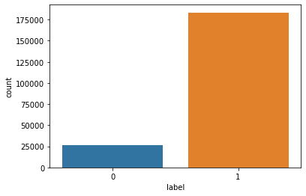
Data Visualization
sns.countplot(x='label',data=data)
plt.show

Slide 11
description
In today’s world, a lot of data is being generated on a daily basis. And sometimes to analyze this data for certain trends, patterns may become difficult if the data is in its raw format. To overcome this data visualization comes into play. Data visualization provides a good, organized pictorial representation of the data which makes it easier to understand, observe, analyze. In this tutorial, we will discuss how to visualize data using Python.

Slide 12
The library which we are using for data visualization are as follow:-
Matplotlib
Seaborn
Bokeh
Plotly
Matplotlib is an easy-to-use, low-level data visualization library that is built on NumPy arrays. It consists of various plots like scatter plot, line plot, histogram, etc. Matplotlib provides a lot of flexibility.
Seaborn is a high-level interface built on top of the Matplotlib. It provides beautiful design styles and color palettes to make more attractive graphs.
We are using Seaborn in this dataset

Slide 13
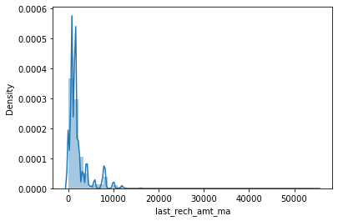
# Making of distplot to show the skewness in different columns for g in data.describe().columns: sns.distplot(data[g]) plt.show()

Slide 14
There are lot of skewness and outlier in the dataset.In Visualization we have used bivariate analysis with all the columns with the target column ‘‘label’’.
Data.skew() will provide indormation about the skewness.if the value is between ‘0 to 1’ and ‘-0 to -1’ then it is acceptable but if the value is more then we have to remove the skewness from the column in which it is present.In our dataset we have lot of skewness in the column such as
aon ==10.392949
daily_decr30 ==3.946230
daily_decr90 ==4.252565
rental30 ==4.521929
Rental90== 4.437681
last_rech_date_ma ==14.790974
last_rech_date_da ==14.814857

Slide 15
last_rech_amt_ma ==3.781149
cnt_ma_rech30 ==3.283842
fr_ma_rech30 ==14.772833
sumamnt_ma_rech30 ==6.38678
medianamnt_ma_rech==30 3.512324
medianmarechprebal30 ==14.779875
cnt_ma_rech90 ==3.425254
medianmarechprebal90 ==44.880503
cnt_da_rech30== 17.818364
fr_da_rech30 ==14.776430
cnt_da_rech90 ==27.267278
fr_da_rech90 ==28.988083
maxamnt_loans30 ==17.658052
medianamnt_loans30== 4.551043
cnt_loans90 ==16.594408
medianamnt_loans90 ==4.895720
payback30 ==8.310695
payback90 ==6.899951

Slide 16
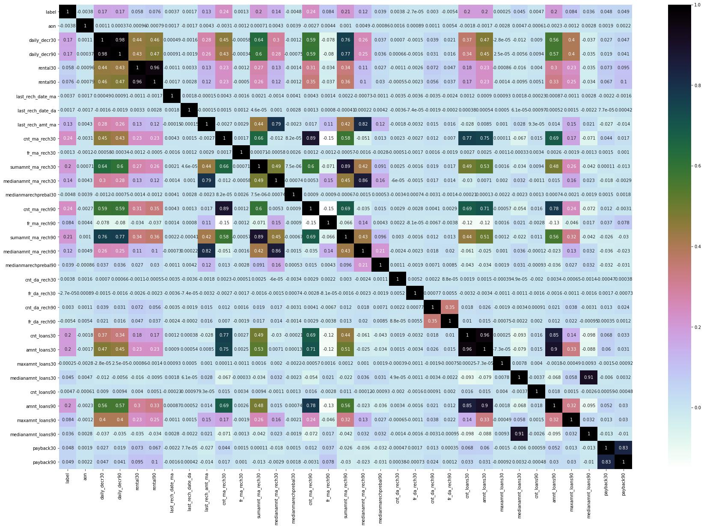
# Plotting of correlation matrix. plt.figure(figsize=(30,20)) sns.heatmap(data.corr(),annot=True,cmap='cubehelix_r')

Slide 17
OBSERVATION
'daily_decr30' and 'daily_decr90' are positively related to each other
'rental30' and 'rental90' are positively related to each other
'cnt_loans30' and 'amnt_loans30' are positively related to each other
'payback30' and 'payback90' are positively related to each other

Slide 18
We will delete the column which have no relation ship
with the target column.
So we will delete the column such as:-
Unnamed:0
Msisdn
Pcircle
Pdate
All the columns did not provide any information in the dataset.

Slide 19
We will use PowerTransformer to remove the skewness:- from sklearn.preprocessing import PowerTransformer
pt=PowerTransformer(method='yeo-johnson')
for i in data.skew().index[1:]:
if data.skew().loc[i]>0.55:
data[i]=pt.fit_transform(data[i].values.reshape(-1,1))
if data.skew().loc[i]<-0.55:
data[i]=pt.fit_transform(data[i].values.reshape(-1,1))
else:
data[i]=data[i]

Slide 20
We are using PowerTransformer in the value lie between
>0.55 and <-0.55
This will make the data lie in that range between -1 to 1
This will remove the skewness from the dataset.
Now our target is to remove the Outlier

Slide 21
We will remove the oulier using Z-score
#Removing of outliers using Zscore.
z=np.abs(zscore(data))
threshold=3
data_new=data[(z<3).all(axis=1)]
If the Z-score value is greater than or less than 3 or -3 respectively, that data point will be identified as outliers.Thatswhy we keep z value less than 3

Slide 22
Data Selection:-
Earlier in the data set the value of the defaulter=26162
non-defaulter=183431
After removing skewness and the outlier,we got the new_data in that we have
defaulter=22722
non-defaulter=147866

Slide 23
Splitting the data into “X” as the feature and “Y” as the vector or label
# Splitting the data into x and y for train test split.
x=data_new.drop(['label'],axis=1)
y=data_new['label']

Slide 24
Using MinMaxScaler
from sklearn.preprocessing import MinMaxScaler(Importing MinMaxScaler)
Transform features by scaling each feature to a given range.
This estimator scales and translates each feature individually such that it is in the given range on the training set, e.g. between zero and one.

Slide 25
Using SMOTETomek for handling Imbalanced data which uses under_sampling method
We have resample the “x” and “Y” data using SmoteTomek.
# X_res, y_res = smt.fit_resample(x,y)
smt = SMOTE()
X_res, y_res = smote.fit_resample(x,y)

Slide 26
Then we will train and test the data using train_test_split
x_train,x_test,y_train,y_test=train_test_split
(X_res,y_res,test_size=.30,random_state=40)

Slide 27
Building the model
Applying cross validation to the best model to see if it is under fitting or over fitting
from sklearn.model_selection import cross_val_score
list=[RandomForestClassifier(),DecisionTreeClassifier(),GaussianNB(),LogisticRegression()]
We will predit the accuracy score and classification report of all the model and the we will cross-validate and see which has less difference between the accuracy score nad the cross-validation score.

Slide 28
Hyper-parameter using Kfold and the GridSearchCV
We use these technique to find out the best parameter and then we compare with the accuracy score and the F1 score.

Slide 29
 | Models | Accuracy Score | F1 Score
0 | RandomForestClassifier | 93.719567 | 0.936767
1 | DecisionTreeClassifier | 89.282011 | 0.891510
2 | LogisticRegression | 77.871957 | 0.774883

Slide 30
So from the above table we can conclude that “RandomForestClassifier” gave the higgest accuracy score and F1 score.
It improved the model with best accuracy.
So will also draw the Roc_Auc_Curve of the following model.
At last we will save the model using Joblib
import joblib
joblib.dump(rf,'microcredit_Defaulter_Indonesia.pkl')

Slide 31
Conclusion:-
In this project we predicted various methods to derive the accuracy score and the classification report so that we can conclude the best accuracy with the best model.
We used hyper-parameter techinique so that we can improve our accuracy score.
So while using “RandomForestClassifier” , we predicted with 93.7% accuracy score.

